Slide 1
VIRTUAL LAB INTRODUCTION
Roger Gu

Slide 2
User Polices
VLAB Login Design:
  Support login via Office account (lezhang/******).
  Support login via QA LADP server account (lezhang/******)
  Not support account change, must modify by Administrator
Default Permission Groups:
  QA2 Function Team
  QA2 Wireless Team
  AUTO, DEV Team (part)
How to add your account to VLAB?
  Connect VLAB administrator(Neil Zhang/Roger Gu), provide your Office account name
  Admin will add your name to VLAB and assign VLANs
  So far, Your can use office or QA account to login

Slide 3
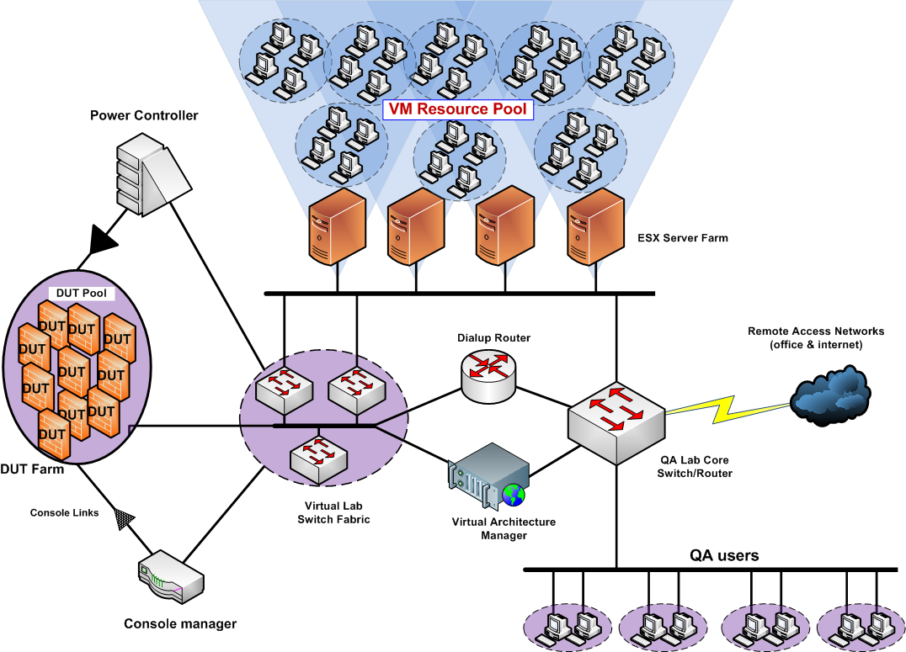
Virtual Lab Structure
CDU
Switch
CM
VL_DB

Slide 4
User Restrict
LAB Devices:
  Forbid add/move devices privately in LAB
  Forbid inset/pull out/move the reticle privately in LAB
VLAN in VLAB(3 types):
  Administrative VLANs (3)
  Local VLANs (10)
  To US VLAN 200
  Forbid use unauthorized VLAN in LAB and VMs
  Forbid configuring unauthorized VLAN to Private VMs(Vcenter)
Notes:
There are 2 types of VLANs used :
•Administrative VLANs (3) : These are VLANs with Layer 3 (IP/IPv6) features. They are used to provide remote network access to the Virtual infrastructure resources. The IP addresses of the admin VLANs are routable throughout the company network and may also be used to access the Internet.
•Local VLANs (10): These are VLANs that may only be used create user topologies and they do not have corresponding layer 3 features. It’s recommended that when testing, the LAN zone & DMZ (and other “internal” zones) be placed in these VLANs while networks that require routing and/or external/remote access be placed in Admin VLANs.

Slide 5
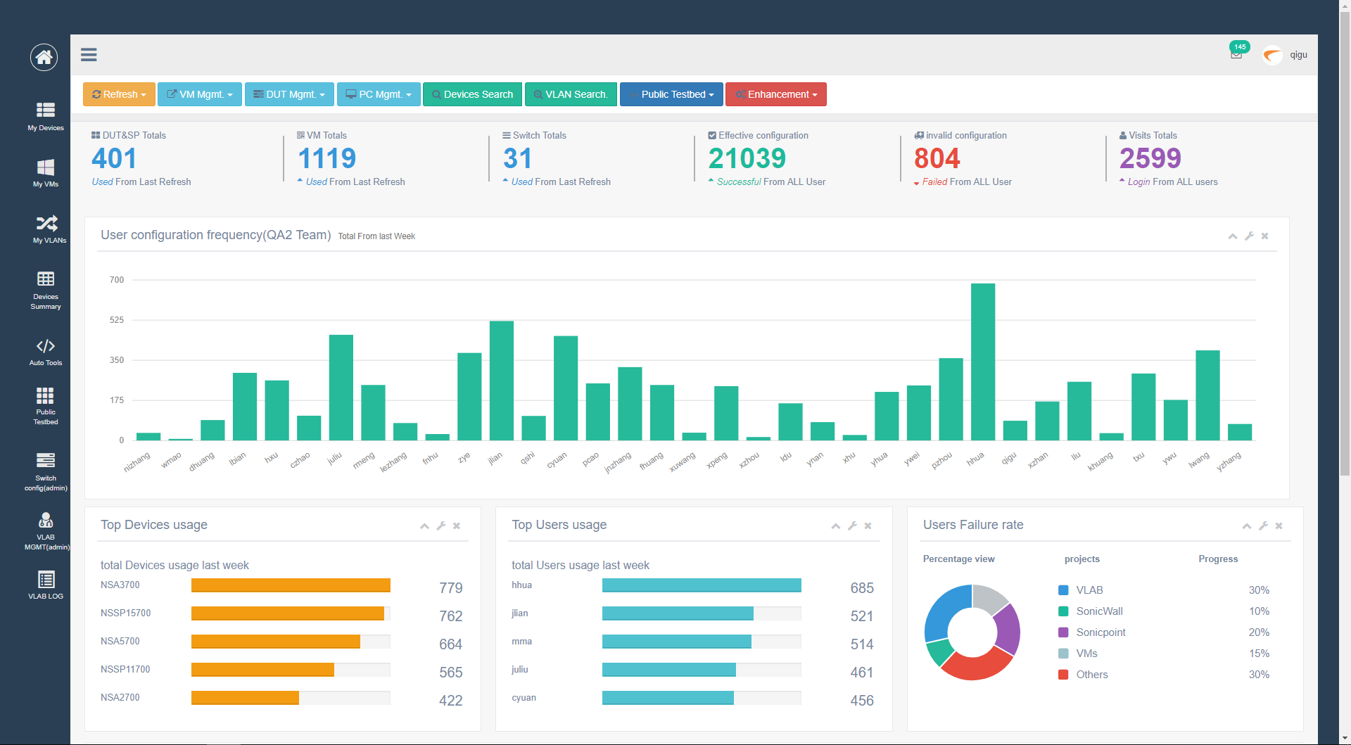

Slide 6
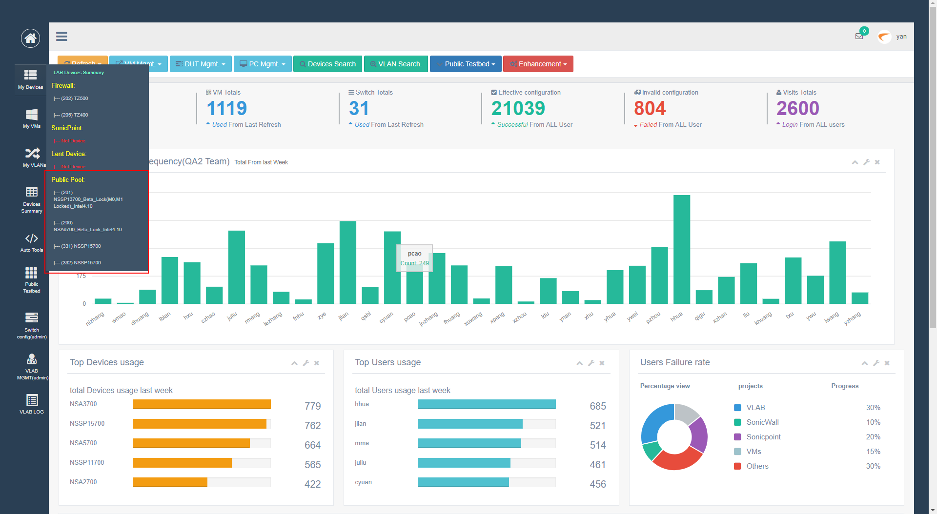

Slide 7
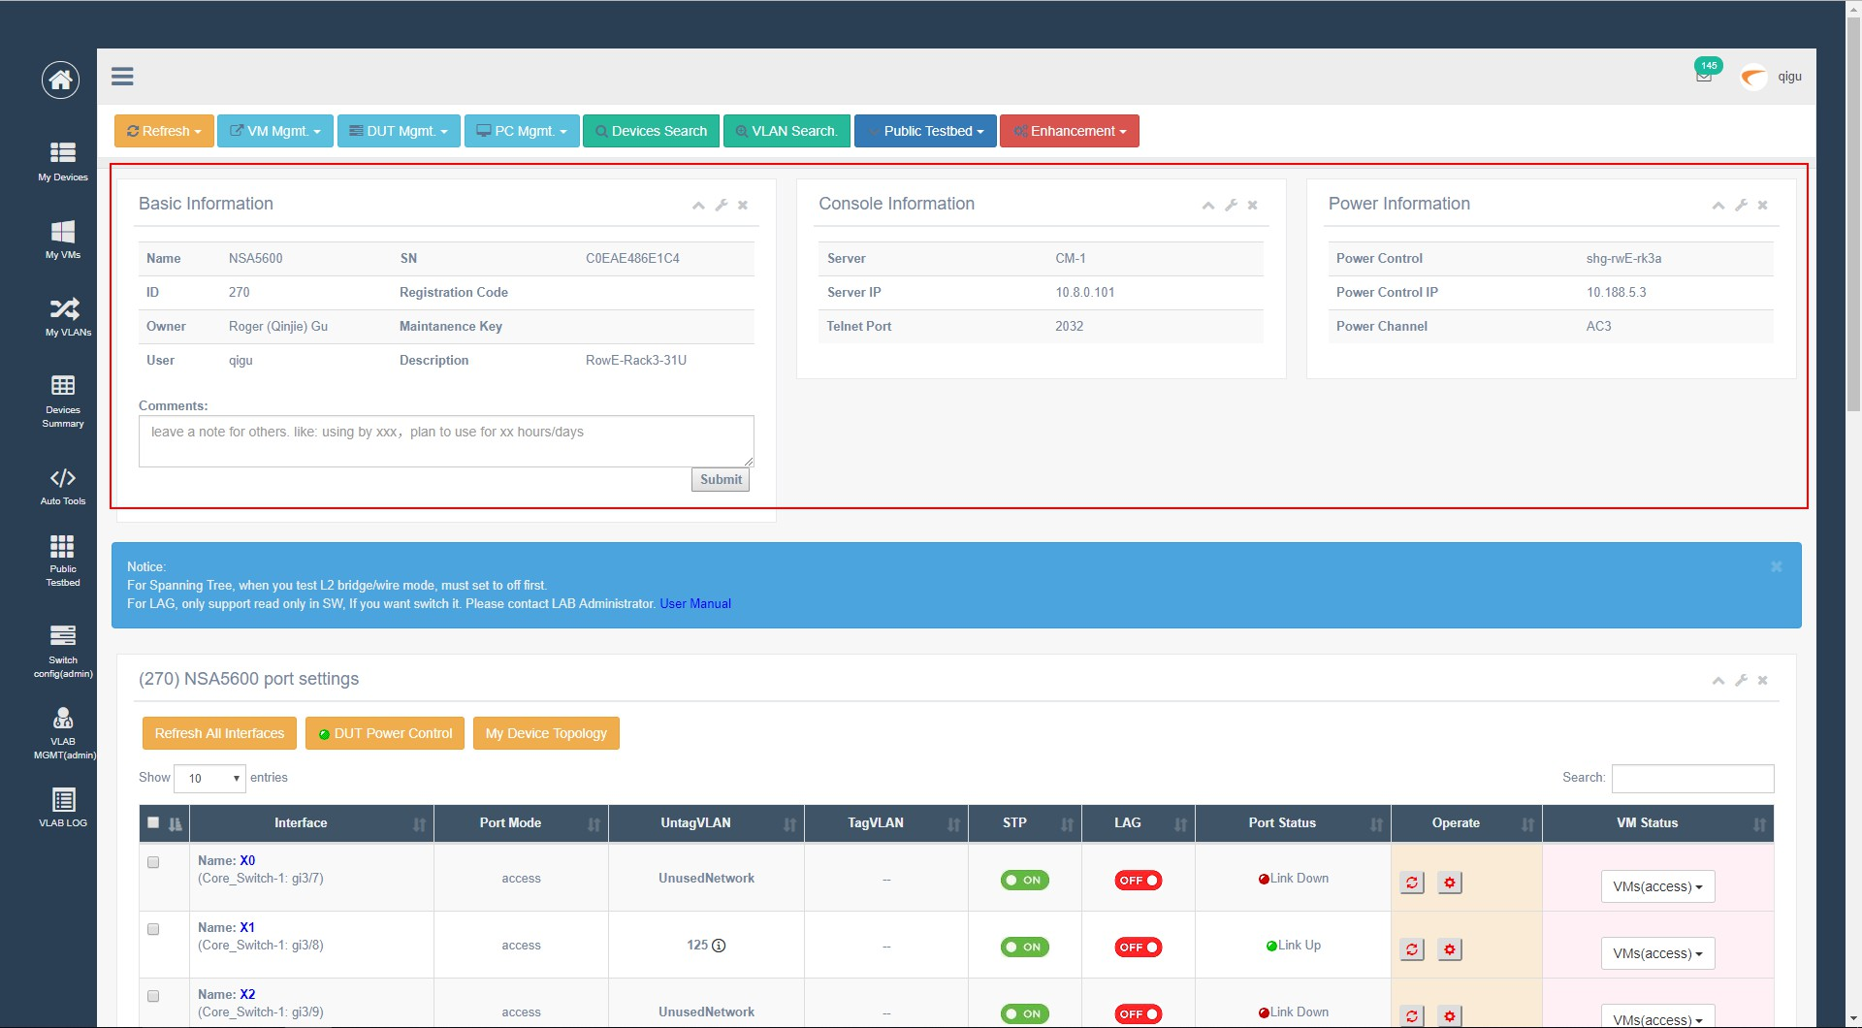

Slide 8
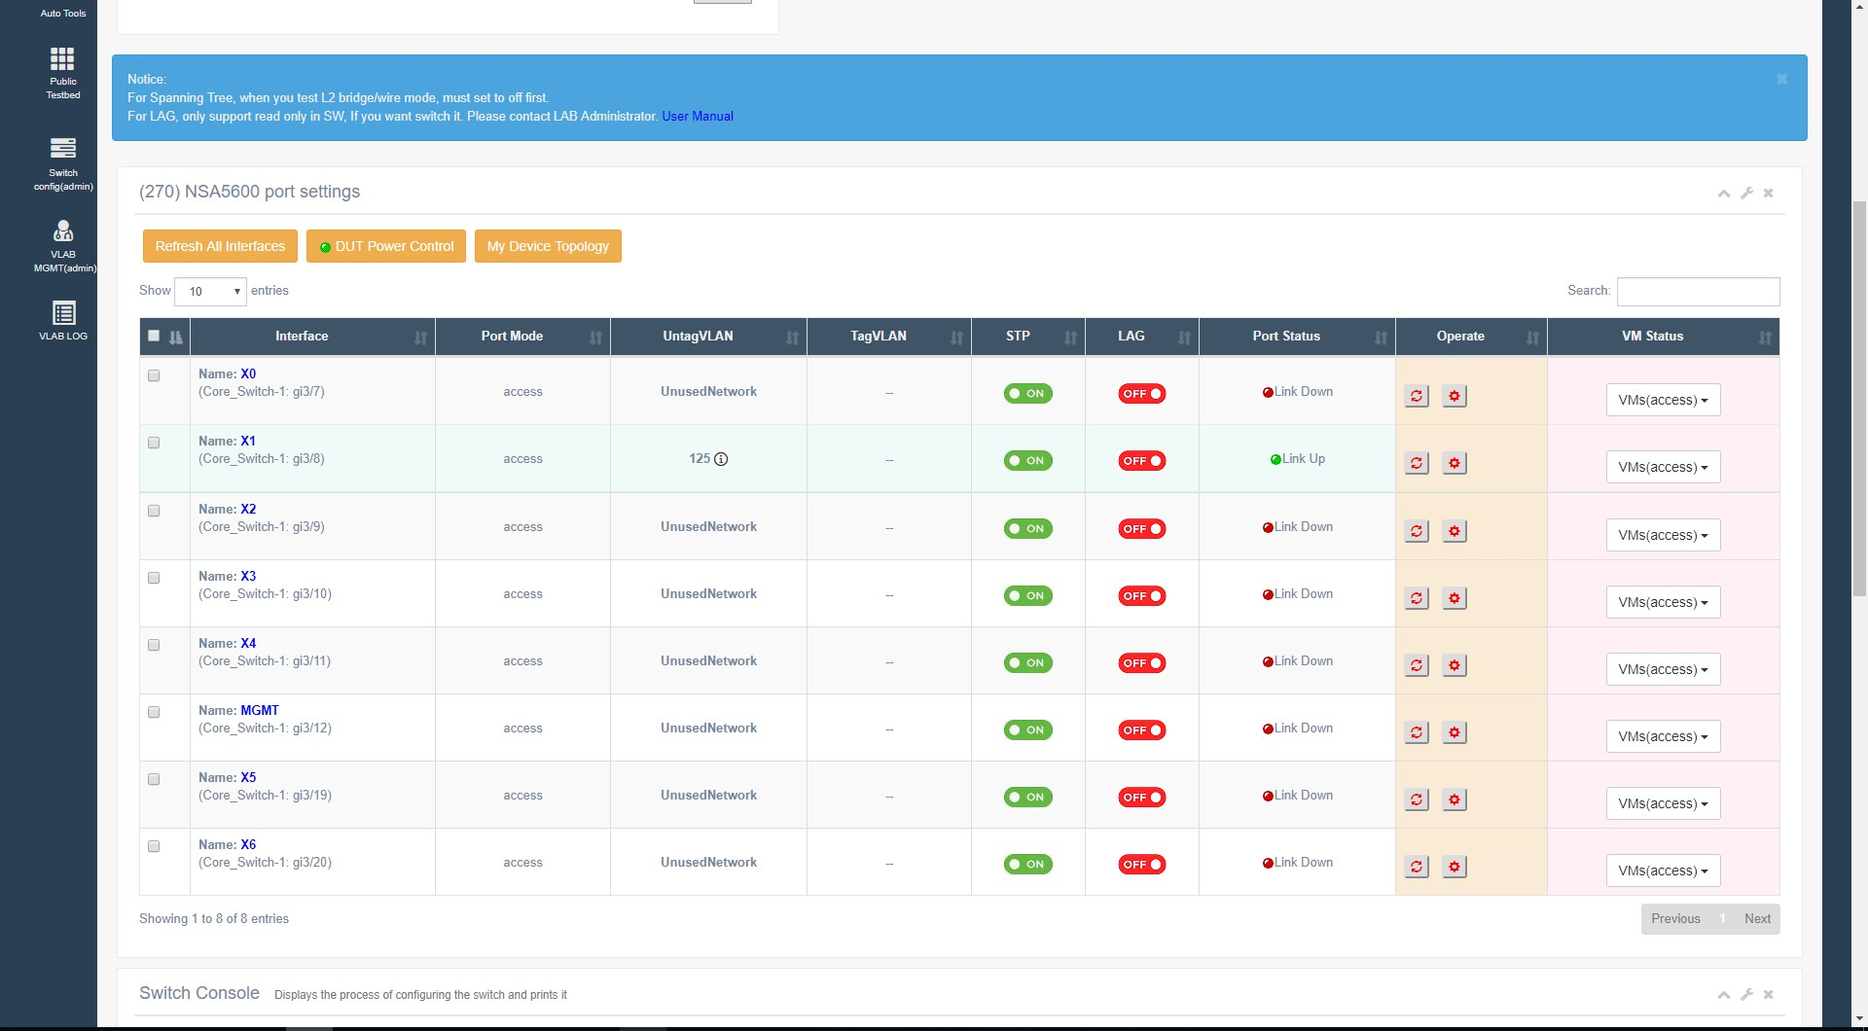

Slide 9
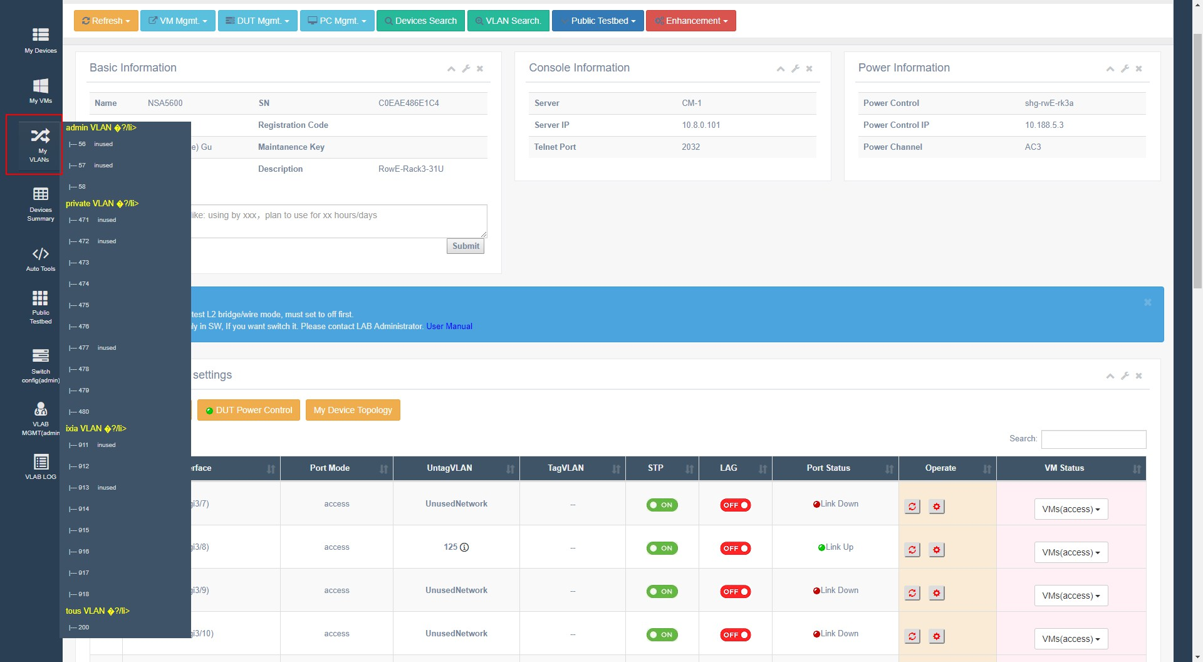

Slide 10
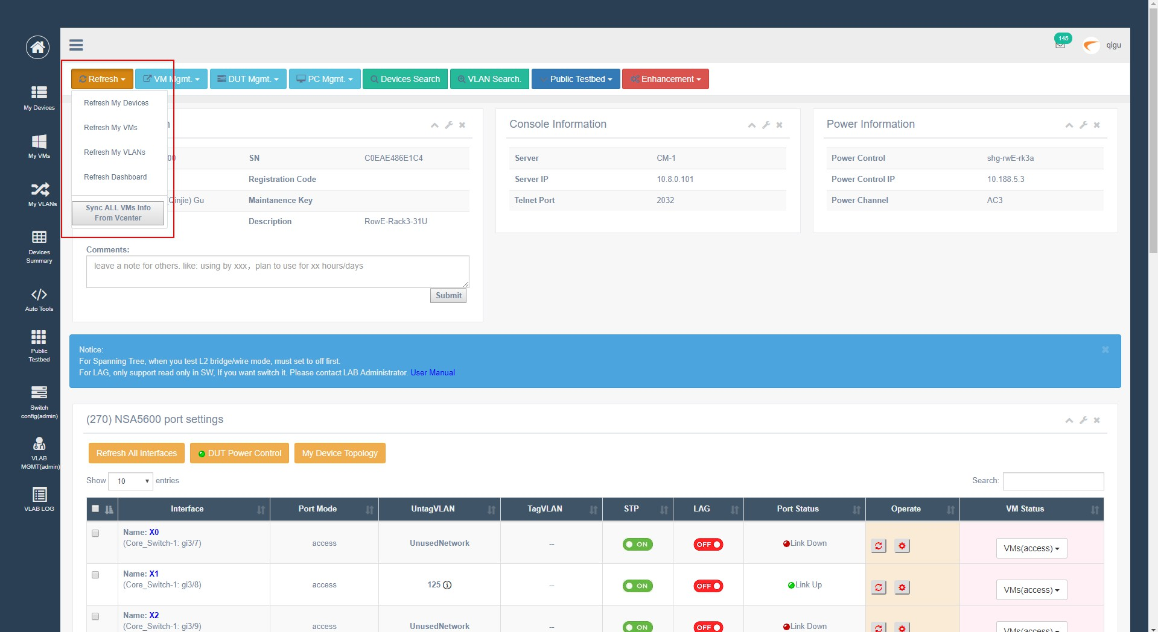

Slide 11
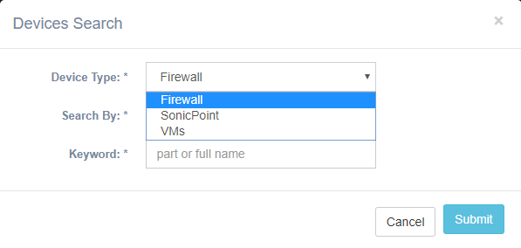
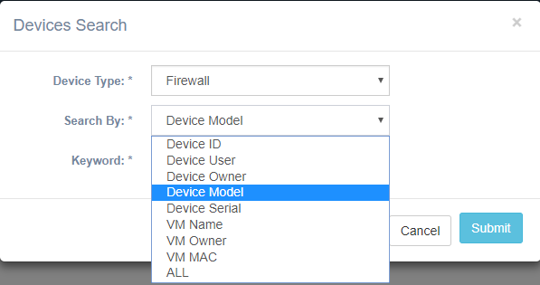
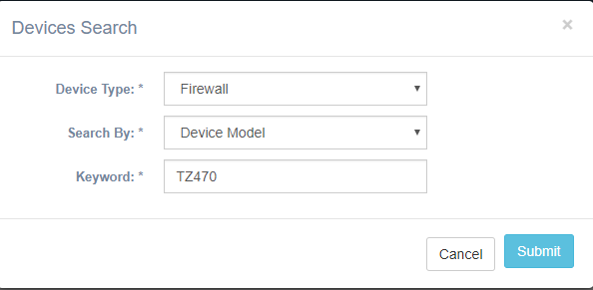

Slide 12
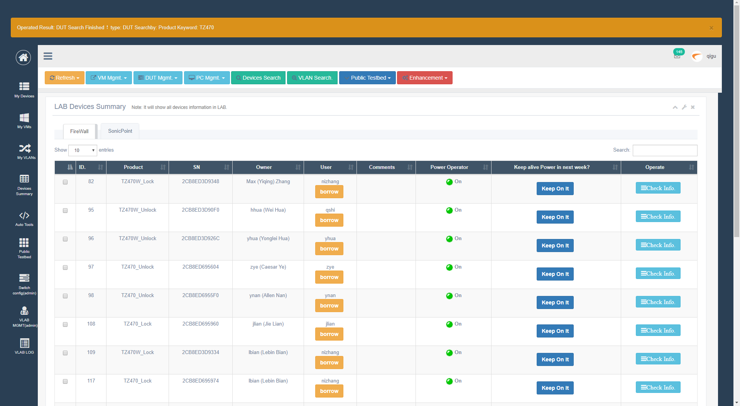

Slide 13
Accessing Virtual LAB
VLAB Site:
    https://vlab.eng.sonicwall.com
    https://10.103.2.123
User Guide:
    https://engineering.eng.sonicwall.com/display/SQ/Shanghai+QA+Virtual+Lab+User+Guide

Slide 14
Thank You!

